Slide 1
Grant Map
HackBU 2020
Ethan Huang, Marleen Moise, Daphnie Sainvilus, Max Samson

Slide 2
Agenda
Introduction
Objective
Design
Live Demo
Conclusion
Future Improvements

Slide 3
Introduction
Finding grant applications is a hard process to begin with — non-profits often struggle to find clear information about granting opportunities from statewide, national, and local foundations
For many small non-profits, the best source of grant money is within the local community through local community foundations, but finding these foundations can be elusive.

Slide 4
Introduction (continued)
Search tools such as Foundation Directory Online exist to help non-profits find grantmakers and access information about their donor histories — but they’re overly complex and fail to focus in on information on local community foundations
Our product locates a non-profit within a city and only displays the community foundations that are nearby, and also provides information on local non-profits to potential donors.

Slide 5
Objective
To connect local non-profits to nearby community foundations
Create clearer search criteria that limits the results of foundation searching
Create transparency between nonprofits and community foundations by making grantmaking information open to the public.

Slide 6
Design Features

Slide 7
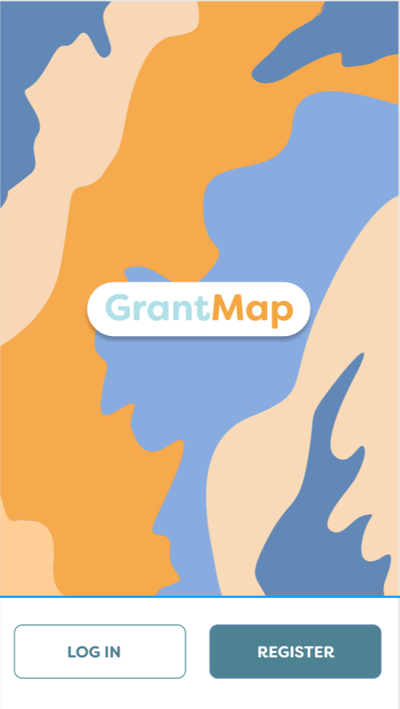
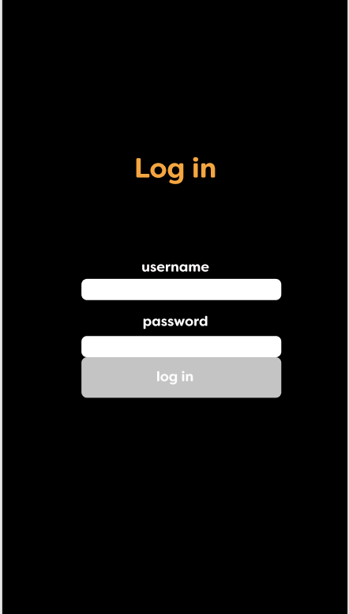

Slide 8
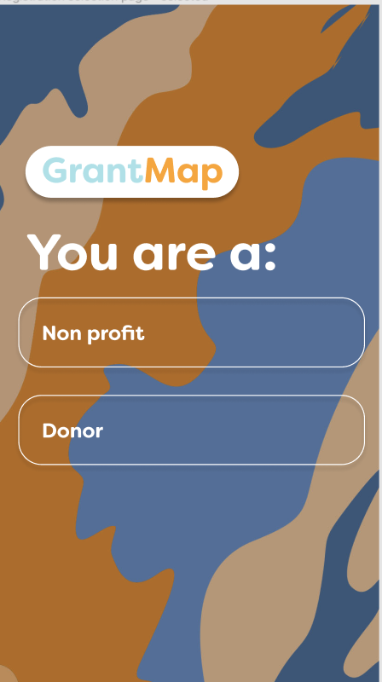

Slide 9
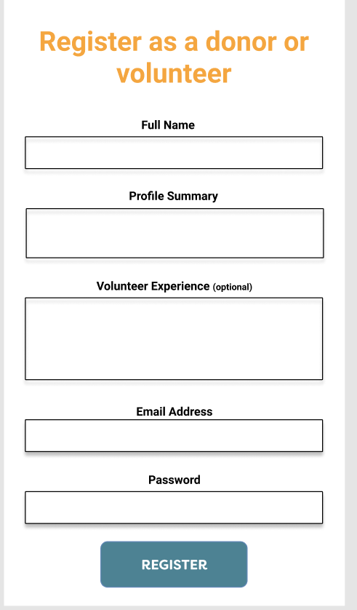
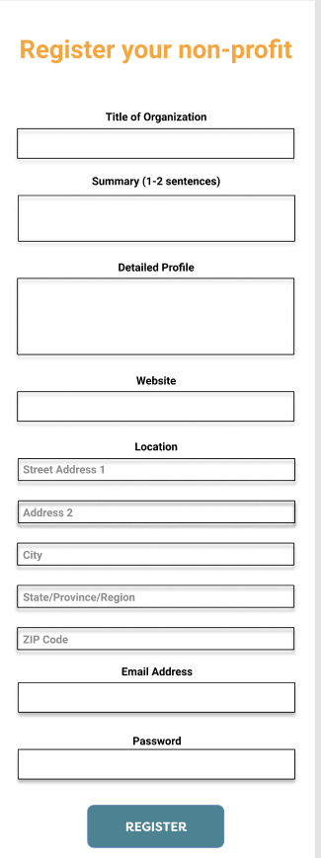

Slide 10
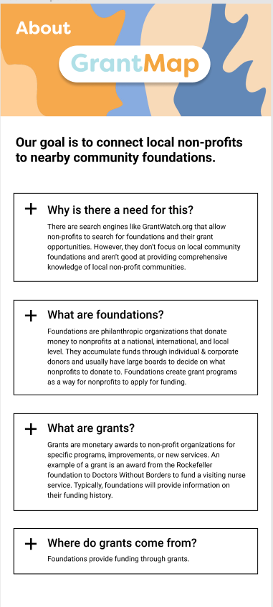
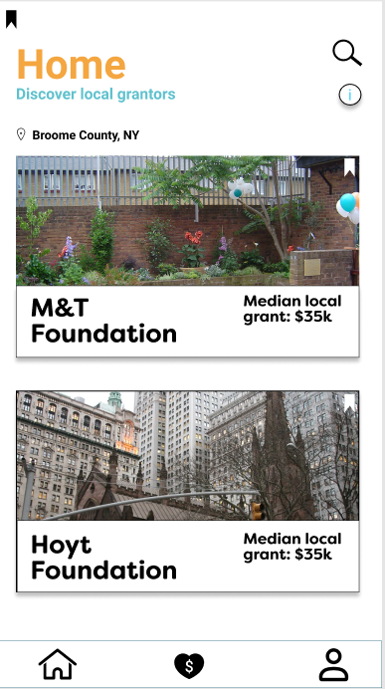

Slide 11
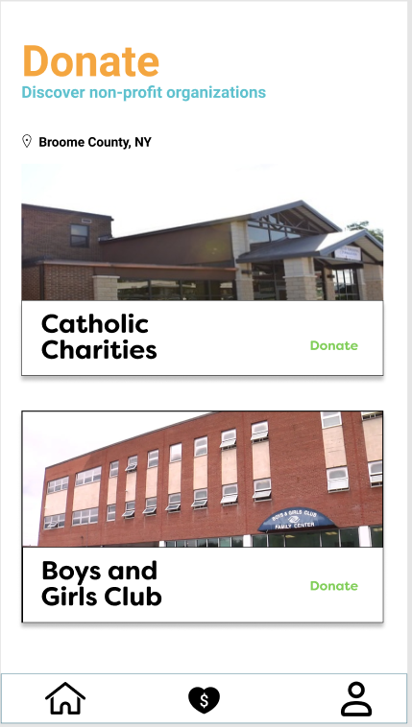

Slide 12
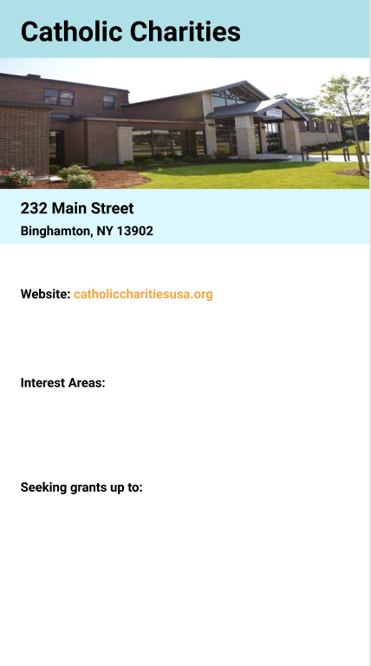

Slide 13
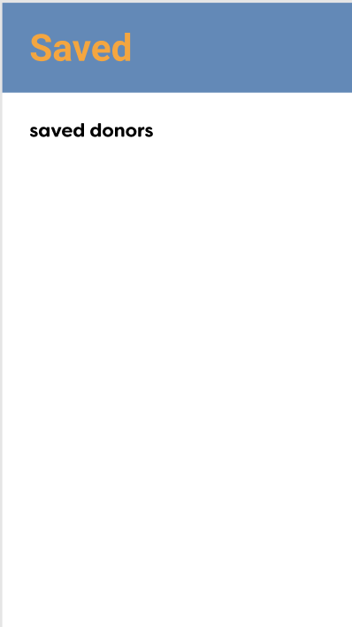

Slide 14

Live Demo

Slide 15
Conclusion
Created login and registration
Enabled screen switching
Wire framed comprehensive UI

Slide 16
Future Improvements
More secure user verification process
Grant location page based on distance matrix
Database through a server, not locally stored
Payment method implemented into Donation page

